Slide 1
Introduction to DCAF
Benjamin Celis

Slide 2
Abstract
Learn about a powerful open source tool that provides out of box functionality, a higher level of abstraction, and a correct-by-construction methodology to help users build more powerful, more flexible, embedded control applications in less time.

Slide 3
Agenda
Introduction
Modules
Engine
Configuration
Demo
Project Templates
Scripting
Include VI
GitHub

Slide 4

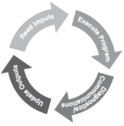
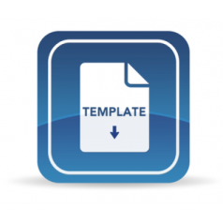

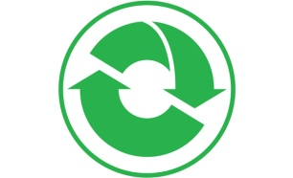



Distributed Control and Automation Framework (DCAF) Overview
An open-source LabVIEW framework for creating configurable, latest value, data engines that can acquire data from multiple input sources, process that data, and then route it back to outputs or to data services.
Create higher quality control applications, in less time.
Scalable and extensible plugin
architecture
Develop with plugin templates
Reuse existing plugins
Define and configure plugin
parameters
Single point I/O, processing, and
data services
Rules for correct-by-construction
software
Configure timing and error handling
Optimized for real-time execution
Notes:
The Tag Bus Data Framework or TBDF is an open-source LabVIEW framework for creating configurable, latest value, data engines that can acquire data from multiple input sources, process that data, and then route it back to outputs or to data services. It provides a scalable and extensible plugin architecture. It supports users in the development of new plugins with a variety of templates… …and the framework was designed to allow plugins to be reused easily across projects. Reuse is easy because each plugin can define configuration parameters which can be specified using a configuration editor. This also allows plugin behavior to change across multiple deployments of the same application. While applicable to a wide variety of use-cases, the framework was primarily built for applications using a lot of single point I/O: things like control data or industrial communication protocols. The plugin architecture helps facilitate multideveloper teams, and the framework handles the intricacies of execution timing and error handling for its users. Finally, while the framework can run on RT, Windows, and Interact with FPGAs, it was built primarily for applications executing on a real-time OS.

Slide 5
Why did we create the framework?
Writing good embedded applications is Hard
Many concepts and good practices are required to write good embedded code
Most embedded applications have the same components in common
Most embedded applications are dynamic and need configuration
All applications need error handling

Slide 6
Who should use the framework?
New developers in LabVIEW:
Allows them to work on what the application has to do, rather than how they have to do it.
Abstracts Real Time concepts for the user
Provides a configurable I/O Abstraction layer
Forces good programing practices
Advanced developers:
Efficient data mapping engine
Extensible configuration interface
Excellent code reuse between projects
Know LabVIEW but doesn’t want to write too much architecture
Open source and distributed in components that are useful individually

Slide 7
How?
Project Templates
Configuration
Runtime
Templates
Configuration Editor
Engine
Examples
Modules
Notes:
From DevGuide
**Engine**: State machine that executes *Modules* as defined in the *Configuration Editor* and provides a namespace for *Tags*. The Engine also passes data between its *Modules* according to its *Mappings*.
**Module**: A collection of code of varying functionality that executes within an *Engine* and that can interact with the *Tags* of that *Engine*. Some standard *Modules* are installed with DCAF, but users can also create their own.
**Configuration Editor**: A LabVIEW program used to visually define the functionality of each *Engine* and *Module* in DCAF.

Slide 8
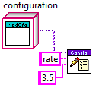
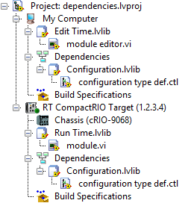
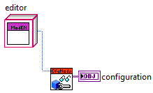

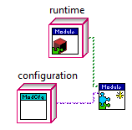
Tag Bus Module Classes
Configuration object serves as API
Editor is a view that creates a configuration
Runtime consumes configuration and executes it

Slide 9
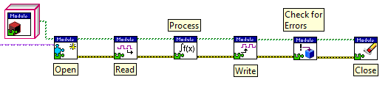
Tag Bus Module Runtime
The Module Runtime class is a simple abstraction layer
Input, Process, and Output methods share data as a Tag Bus data table
The interface provides a method for classifying the severity of an error, calling code is responsible for taking action
The only input to the “Open” function is a configuration object
These are the overridable methods

Slide 10
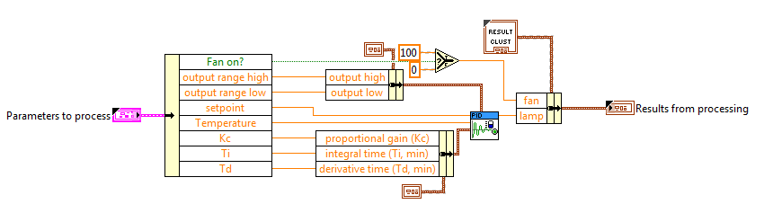
User Control Module
Project template and scripting code to simplify the development process
User only needs to modify runtime class
Control logic inserted into simple subVI with cluster in and out

Slide 11
Application Example: Temperature Controller
HMI
HMI
I/O Module
PID
I/O Module
Modbus
Modbus
TDMS Log

Slide 12
Application Example: Temperature Controller
HMI
HMI
I/O Module
PID
I/O Module
Modbus
Modbus
TDMS Log
Inputs
Process
Outputs

Slide 13
Application Example: Temperature Controller
HMI
HMI
I/O Module
PID
I/O Module
Modbus
Alarms
Modbus
TDMS Log
Input Module
Process Module
Output Module

Slide 14
Engine
Engine
Input
Process
Output

Slide 15
Engine
Tag Bus
Init
Input
Process
Output
Close
Init
Input
Process
Output
Close

Slide 16
Tags
Engine Scope
Have Data Type
Unique Name
Only one writer
Multiple readers
Channels
Module Scope
Have Data Type
Unique Name
Have Flow Direction
Engine
Tag
Input Module
Channel

Slide 17
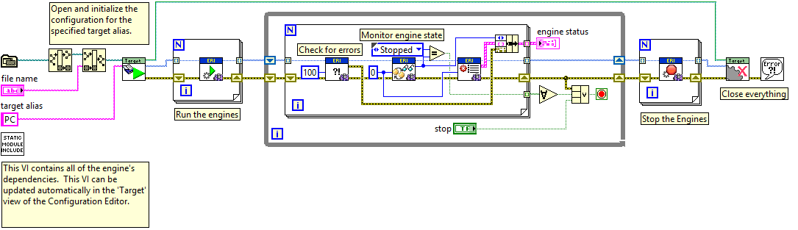
RT Main Code
This code is common for any Tag Bus applications
The Engine API allows us to interact with the Engine
The configuration file defines how many engines are spawned and how which modules are in each engine, as well as what tags are mapped to each channel
Notes:
This is the first piece that is tied to the Tag Bus Framework framework

Slide 18
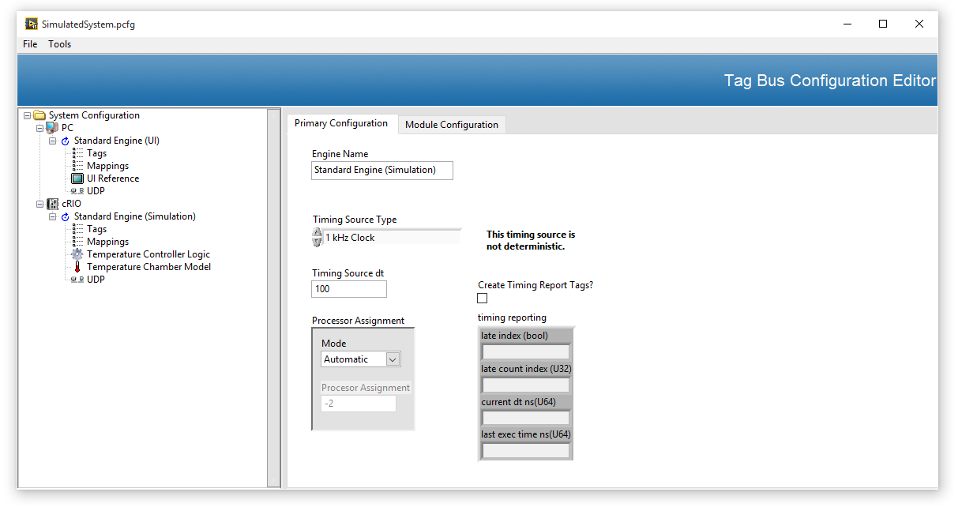
Editor
Based on Configuration Editor Framework CEF
Open source
Tools and APIs to make it easier to use
Current effort in making this easier to use

Slide 19
Demo

Slide 20
When to use tag bus framework
Data Acquisition Loop
Tag based applications
Want to reuse modules already created
I/O abstraction layer
Need configuration
Machine control
System automation
Processing Loop
Publishing Tag Values Loop?
Tag Bus Engine
Modbus Module
TDMS Module

Slide 21
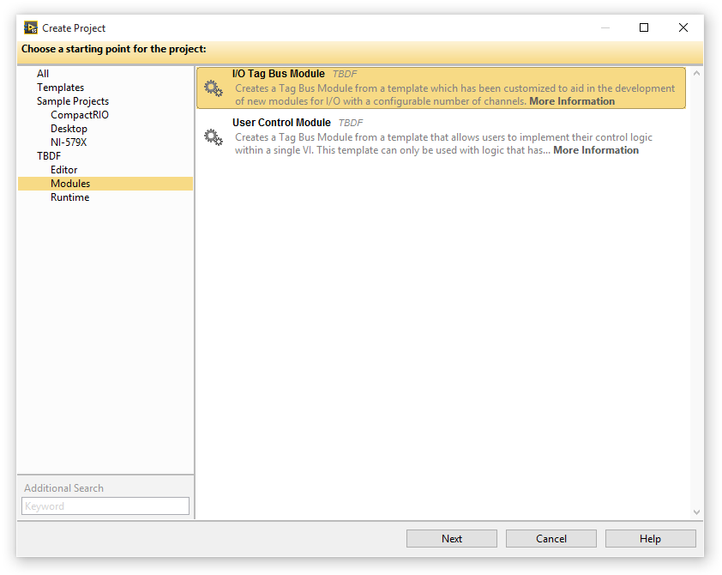
Project Templates
We have project templates for:
Modules
I/O Modules
User Control Modules
Engines
Basic Execution Template
TBD Execution Service
Editor

Slide 22
Include VI
Trick to make deployment easier to RT targets
Scripting utility to create this VI

Slide 23
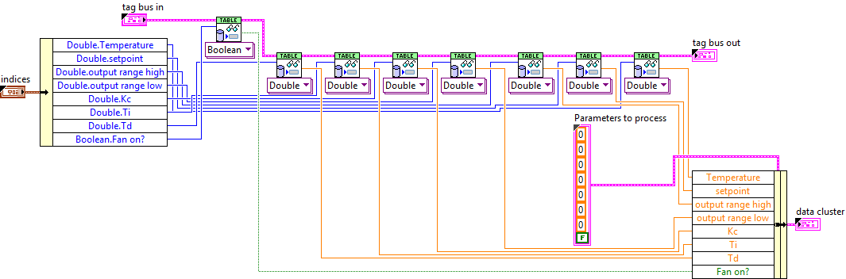
Module Scripting

Slide 24
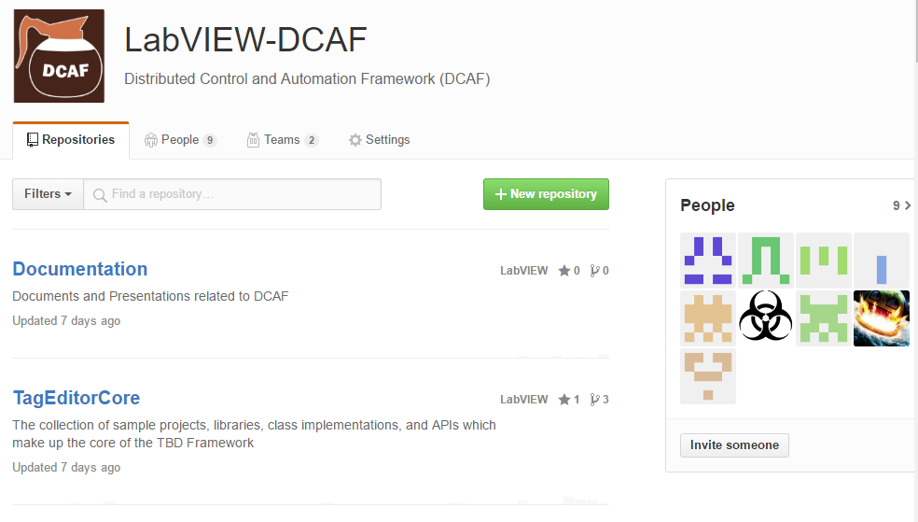
GitHub
Collaboration
Issue tracking
Open Source Code

Slide 25
You should not use it if:
You don’t want to reuse code
You prefer to write custom architectures for each application
Like race conditions
Like configuration errors
Need to work more hours in a project

Slide 26
Questions?

Slide 27
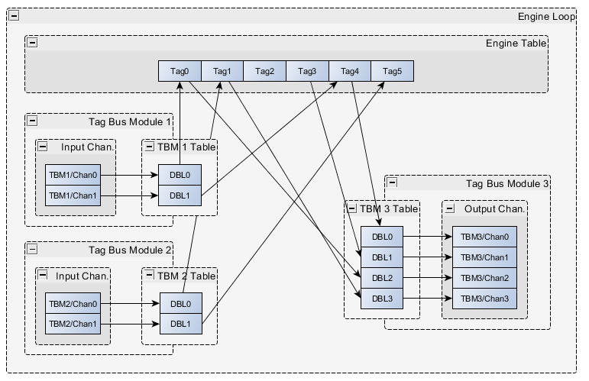
Dynamic Data Flow
The engine grabs the fixed data buffers from Module 1 and 2 and stores that data in the engine data buffer
The engine then routes data from its engine buffer into Module 3’s fixed input buffer

